Slide 1

Bookshop Management System
School of Environmental Science and Management
Faculty of Science and Technology
Pokhara University, Nepal
May, 2024
Prepared by:-
Rashni Thapa Magar
Sandip Bhatta
Samyog Khadka
Salina Phago

Slide 2
Contents
Introduction
Problem statement
Objectives
Literature review
Methodology
5.1 Planning and analysis phase
5.2 System design phase
5.3 System development phase
5.4 Testing phase
5.5 Implementation phase
6. Flow chart
7. Data Flow Diagram
8. Result and Outcomes
9. Future work
10. Outcomes

Slide 3
1.Introduction:
A bookshop is a place where a huge collection of books and resources are available which can be accessible by the users. It acts as a brain for the institutions.
This mini-project " Bookshop Management System" is the sample project for managing book details. The project aims at developing Bookshop Management System using the C language that enables an organization to maintain its transactions. The BMS is basically for management of incoming and outgoing materials from the bookshop. It will reduce paperwork and workload of users.
Following are some of the inputs to the bookshop:
Customer name
Book name
Author name
Book Costs
Published year

Slide 4
2.Problem Statement:
One notable problem with bookshop management system 20 years ago was their reliance on manual inventory tracking process. This manual approach was time-consuming, prone to errors, and lacked real-time updates. When a book was sold, its staff had to manually update the inventory records.
Overall, the lack of an automated inventory management system hindered book shops' availability to operate efficiently, optimize their inventory, and provide a seamless shopping experience for customers.

Slide 5
3.Objective:
The objective of a BMS project developed in C language aimed at solving manual inventory tracking process is to streamline and automate inventory management tasks to improve efficiency, accuracy within the bookshop.
Automation of Inventory Tracking :-
The primary goal is to eliminate manual record keeping by implementing a system that automatically updates inventory levels in real-time as books are bought, or sold.

Slide 6
4. Literature Review:
The development of Bookshop Management System (BMS) has been a topic of interest for researchers and practitioners in the field of computer science and information technology. Several studies have explored the design and implementation of such systems using various programming languages and technologies.
One of the early studies in this domain was conducted by Smith et al. (2010), who proposed a Bookshop Management System developed in C language. The authors highlighted the advantages of using C, such as its efficiency, scalability, and platform independence, which made it a suitable choice for managing the complex operations of a bookshop.
Later, a study by Patel and Sharma (2015) investigated the integration of a BMS with e-commerce capabilities. They developed a C –based system that allowed customers to browse and purchase books online, while also managing the backend operations of the bookshop.

Slide 7
5.Methodology:
The development of the Bookshop Management System follows a structured methodology to ensure the successful completion of the project.
The methodology will consist of the following phases:
Planning and analyzing phase
System design phase
System development phase
Testing phase
Implementation phase

Slide 8
5.1 Planning and analysis Phase
We conducted meetings and interviews with stakeholders, including bookshop owners, managers, and employees, to understand their needs and pain points. After that, we created a detailed requirements document outlining the functional and non-functional requirements of the system. We analyzed the current processes and workflows in bookshops to identify areas for improvement and automation.
5.2 Design phase
We designed the overall architecture of the Bookshop Management System (BMS). We developed algorithms to perform operations such as adding, searching and updating books quantity from inventory. We designed a simple file using text-based menus or command-line prompts to interact with the system.

Slide 9
5.3 Development Phase
We defined functions for each feature of the system and implemented data structures to store information about books, sales transactions. We prepared algorithms to perform operations and implemented file handling mechanisms to read from and write to files for storing data persistently and error handling mechanisms to deal with invalid inputs.
5.4 Testing Phase
Once the project is completed, thorough testing is conducted to identify any potential flaws in the coding process. All the individual parts or modules of the project are integrated, and the entire system is rigorously tested to identify any errors and assess the overall outcomes. If any errors are detected, they are debugged, and necessary adjustments are made based on user feedback and requirements. This iterative process ensures that the final system is robust, error-free, and aligned with the needs of the end-users. Continuous testing and debugging are performed to ensure the system's reliability and functionality before it is ready for deployment.

Slide 10
5.5 Implementation phase
We tested the project and then implemented it to fulfill the user requirement. Once the project is implemented, it may need additional updating. The successful implementation makes the project complete. The main purpose of implementation is to convert the physical system specifications into working and reliable software. It also refers to the installation of the software so that it may be used in the company.

Slide 11
6. Flow chart:
Start: The system begins its execution.
Enter your choice: The user is prompted to input a numerical choice, representing an action they want to perform.
Choice Validation: A series of 'if' statements check the user's input. Each 'if' condition represents a different function:
if choice == 1: This choice corresponds to "Add books in store."
if choice == 2: This choice corresponds to "Search books."
if choice == 3: This choice corresponds to "Display books available in store."
if choice == 4: This choice corresponds to "Book sold."
if choice == 5: This choice corresponds to "Display sold books."
if choice == 6: This choice corresponds to "Exit."
Function Execution: If the user's input matches a condition (i.e., if they entered '1', '2', '3', etc.), the corresponding function is executed. The system performs the requested book-related operation.
Invalid Choice: If the user's input does not match any of the valid choices, the system prompts them to "Enter valid choice."
End: The system completes its execution.

Slide 12
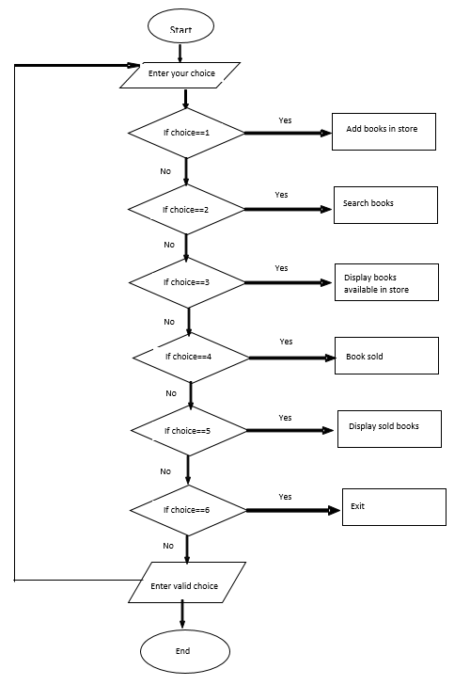
Fig 1 :- Flowchart of BMS

Slide 13
7. Data Flow Diagram:
A Data Flow Diagram (DFD) is a graphical representation of the flow of data through a system. It's a tool used in software engineering and systems analysis to model and design systems, highlighting the flow of data and the processes that transform it. In our project we have developed two levels of DFD.

Slide 14
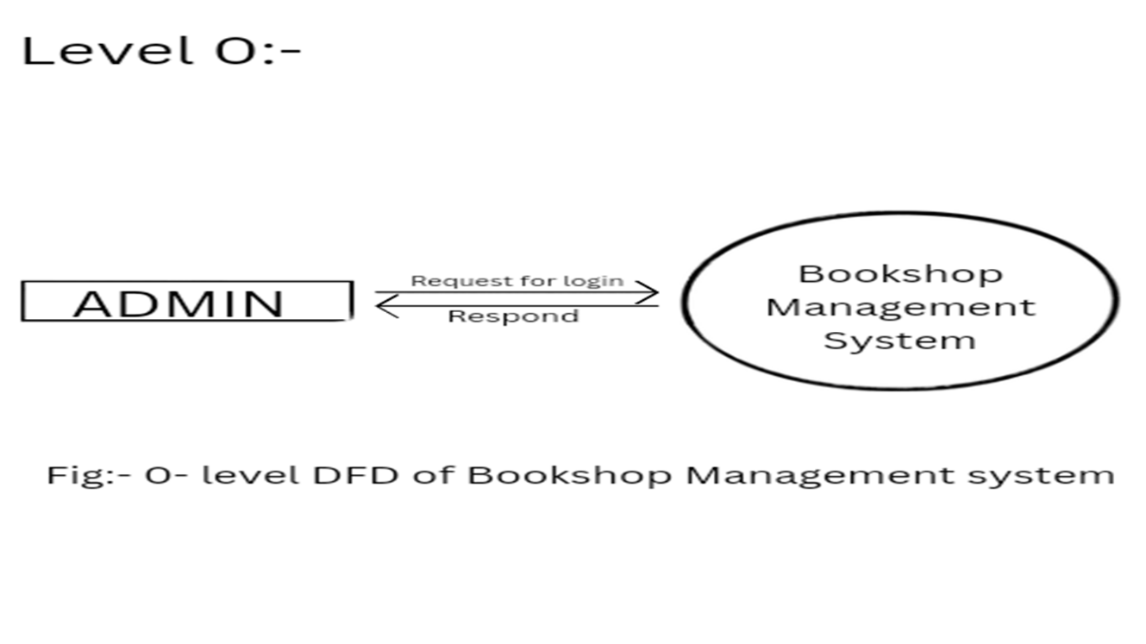
Fig 2 :- Level 0 DFD
This diagram is a Level 0 Data Flow Diagram (DFD) of a Bookshop Management system. It depicts the top-level interactions between the system and its external entities.
Explanation:
ADMIN: Represents the administrator who interacts with the system.
Bookshop Management System: The central process of the system, responsible for managing all aspects of the bookshop.
Request for Login: The administrator sends a request to login to the system.
Respond: The system responds to the login request, granting or denying access.

Slide 15
The Level-1 DFD for a Bookshop Management System is a high-level representation of the system's main functions and how they interact with the ADMIN user and database. The arrows show the flow of requests and responses between the ADMIN each function, and database. The ADMIN requests information or actions, and each function processes the request and sends a response back.
ADMIN is the central entity in this diagram.
Functions/Processes:
Add books to store: The ADMIN can request to add new books to the store. The Database receives this request and adds the new books to its records.
Search books available: The ADMIN can request to search for available books. The Database responds with the list of available books based on the search criteria.
Display books available: The ADMIN can request to display the list of books currently available in the store. The Database provides this information.
Sale books: The ADMIN can request to sell a book. The Database updates its records to mark the book as sold.
Display sold books: The ADMIN can request to view the list of books that have been sold. The Database provides this information.

Slide 16
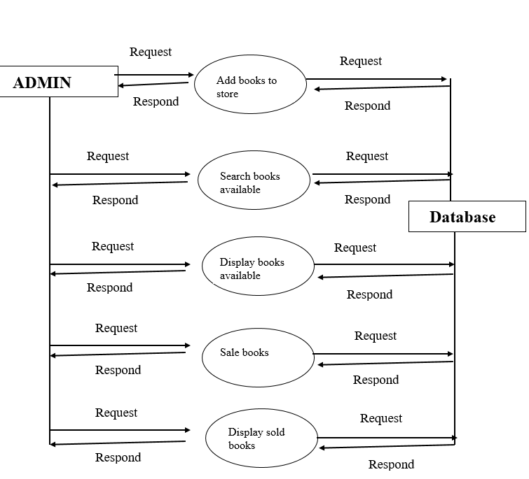
Fig 3 :- Level 1 DFD

Slide 17
8. Result and outcome:
A well-implemented BMS can streamline operations, provide valuable data for decision-making. It can help in inventory management, sales tracking. In the future, with advancements like AI integration, it could offer even more tailored experiences, such as predictive inventory management and enhanced customer engagement through personalized offers and content.

Slide 18
9. Future work :
In the future, we can update our codes in the BMS to integrate new technologies like AI and machine learning. These updates can help in automating tasks such as inventory management, analyzing customer preferences, and providing personalized recommendations. Additionally, enhancing the system's security features to protect customer data and transactions would be essential for the future.

Slide 19
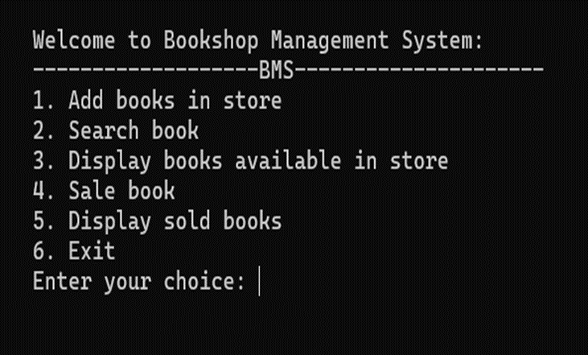
10. Outcomes:

Slide 20
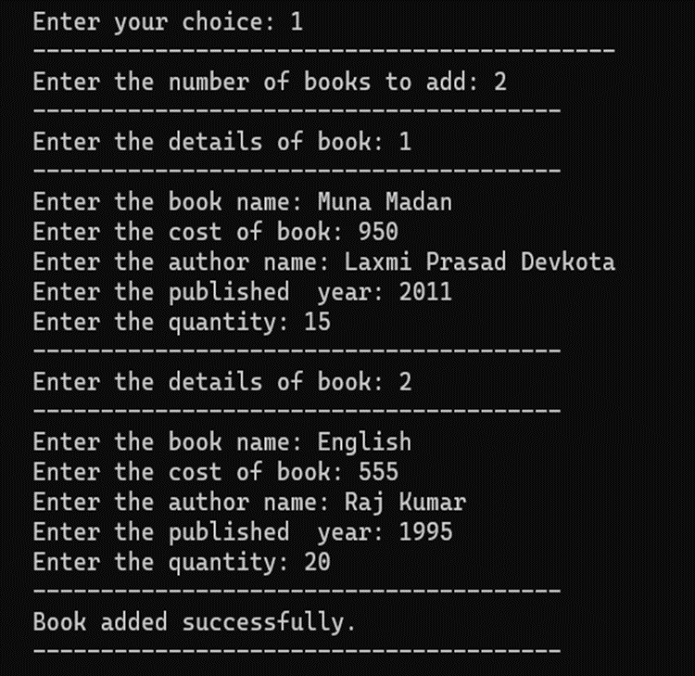
Add books in store :

Slide 21
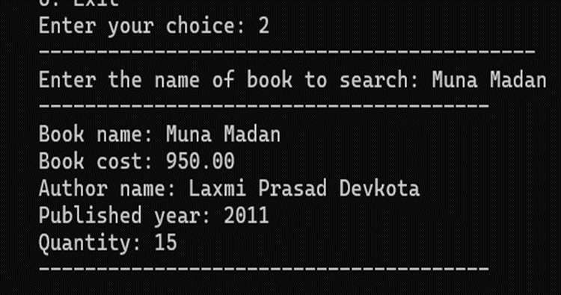
2. Search book :

Slide 22
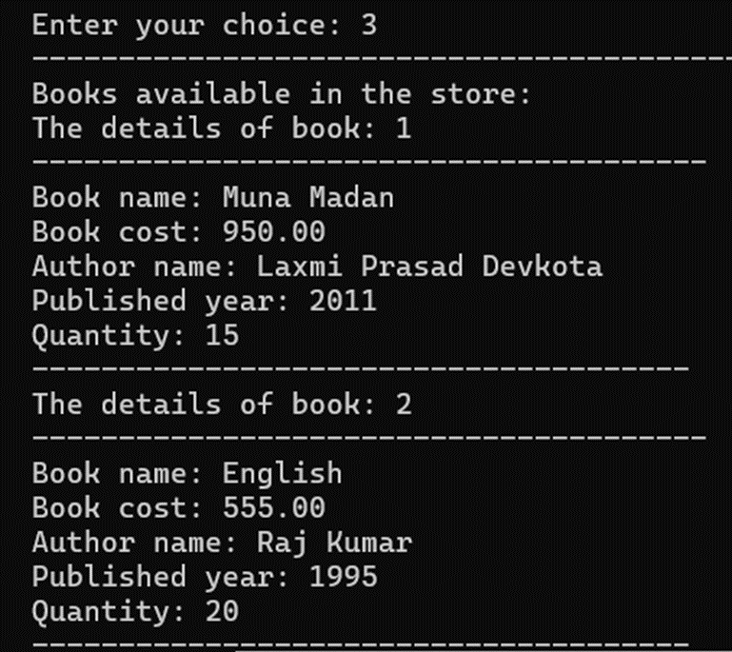
3. Display books available in store :

Slide 23
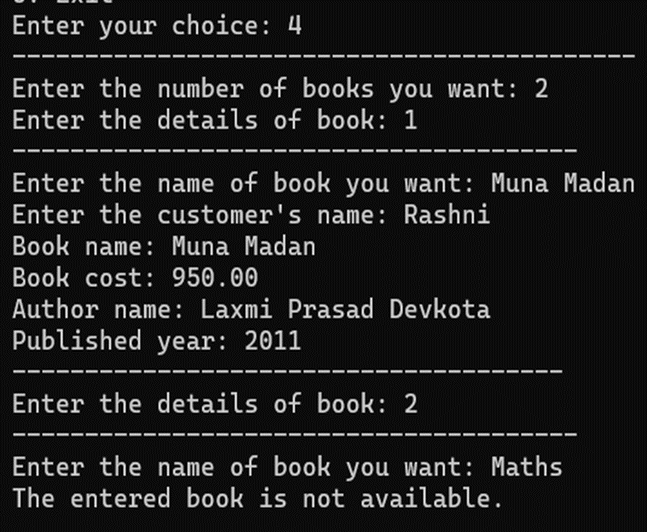
4. Sale book :

Slide 24
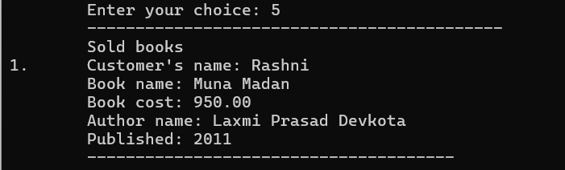
5. Display sold books:

Slide 25
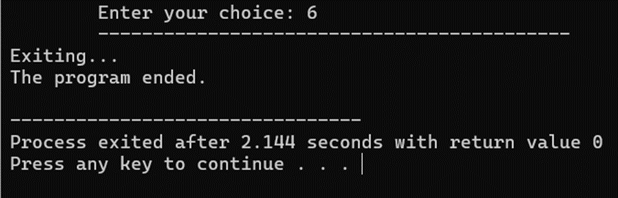
6. Exit:

Slide 26
Thank you.

